Slide 1
2 most important elements in wc
By Matt Fendon, Esq.
Board Certified Worker’s Compensation Specialist

Slide 2
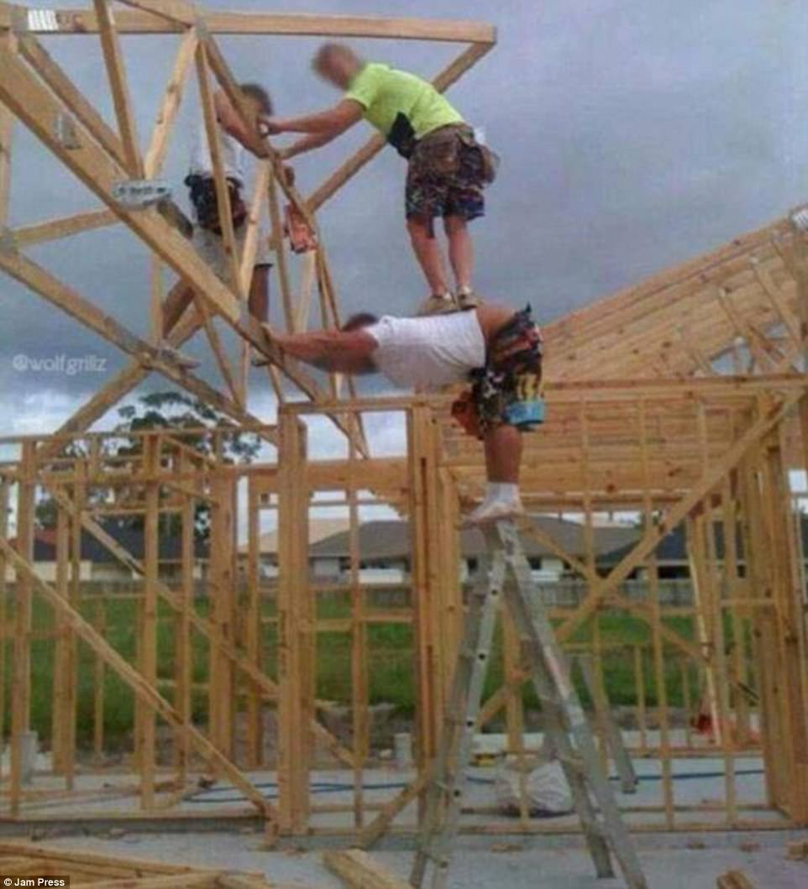
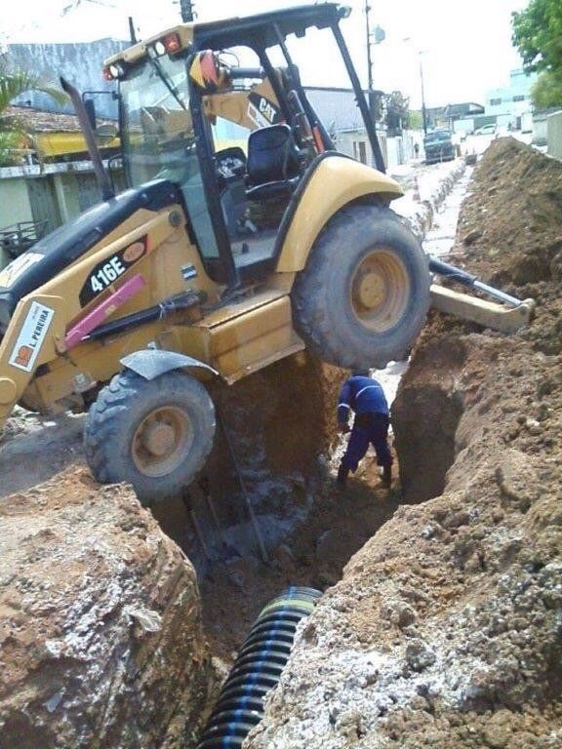
WORK COMP PORN

Slide 3
What Is work comp?
A state governed no fault system where an employee who sustains a personal injury or occupational disease arising out of and in the course of employment by an employer subject to the act is entitled to certain benefits provided by the act unless the employer has some delineated defense and this is the employee’s exclusive remedy against the employer.

Slide 4
ARISING OUT OF AND IN THE COURSE OF EMPLOYMENT (Coe)
RULE OF THUMB – INJURY IN TIME, PLACE AND CIRCUMSTANCES OF EMPLOYMENT (COE), WILL ORDINARILY, BUT NOT NECESSARILY, ARISE OUT OF IT, WHILE AN INJURY ARISING OUT OF EMPLOYMENT ALMOST NECESSARILY OCCURS IN THE COE.

Slide 5
Arising out of
THE INJURY MUST BE CAUSALLY CONNECTED TO IT
ARISING OUT OF IS THE ORIGIN OR CAUSE OF THE INJURY
DEFINITION – WHETHER THE ACCIDENT WAS “CAUSED, IN WHOLE OR IN PART OR CONTRIBUTED BY A NECESSARY RISK OR DANGER OF THE EMPLOYMENT OR INHERENT NATURE THEREOF”
NOT WHETHER EMPLOYMENT INCREASED THE DANGER OR NOT WHETHER EMPLOYEE EXPOSED TO INJURY MORE THAN OTHERS.

Slide 6
ARISING OUT OF
RISK ANALYSIS
WC law is coverage for
injury or death
Caused in whole/part or
Contributed to by necessary or inherent risk related to employment

Slide 7
ARISING OUT OF
ORIGIN OF RISK MAY BE
DISTINCTIVELY WORK RELATED
WHOLLY PERSONAL (NEVER WORK RELATED)
MIXED
PART WORK RELATED/PART PERSONAL
E.G., STREET RISKS – IF THE COE INVOLVES CONTINOUS/REPEATED USE OF STREET
OR NEUTRAL
NEITHER WORK RELATED NOR PERSONAL
EG ACTS OF NATURE, RANDOM ACCIDENTS, UNEXPLAINED ACCIDENTS

Slide 8
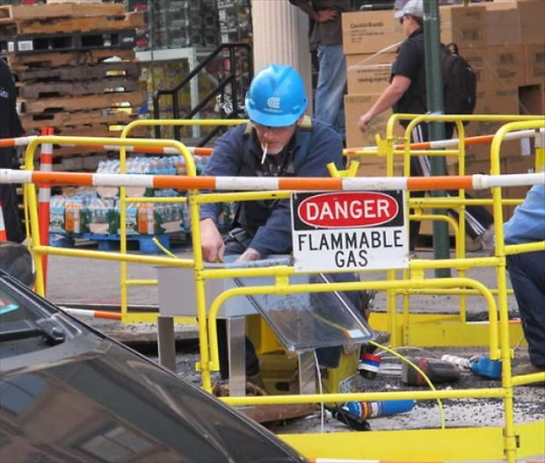
MORE WORK COMP PORN!!

Slide 9
ARISING OUT OF
NATURE OF RISK
PECULIAR (STRONGEST)
INCREASED
ACTUAL
OR POSITIONAL (WEAKEST)

Slide 10
ARISING OUT OF
PECULIAR
ONLY AT WORK – DISTINCTIVELY WORK RELATED
INCREASED
NOT UNIQUE TO WORK BUT GREATER AT WORK
ACTUAL RISK
NOT QUANTIATIVELY GREATER AT WORK BUT RISK OF EMPLOYMENT
EG – WALKING, BENDING, OR SITTING
SUFFICIENT IF THE ORIGIN OF THE RISK IS NOT MIXED AND IN COE
NOT SUFFICIENT IF ORIGIN OF RISK IS MIXED AND OCCURS WITH PERSONAL ACTIVITY (E.G., HERNIATING A DISC USING THE TOILET – SACKS V ICA)
EMPLOYMENT MUST BE A “BUT FOR”
POSITIONAL
WORK PLACES PERSON IN RANDOM SCENARIO WHERE HE/SHE INJURED
IS SUFFICIENT FOR RISKS OF NEUTRAL ORIGIN (E.G., UNEXPLAINED FALLS)
EMPLOYMENT MUST BE A “BUT FOR”

Slide 11
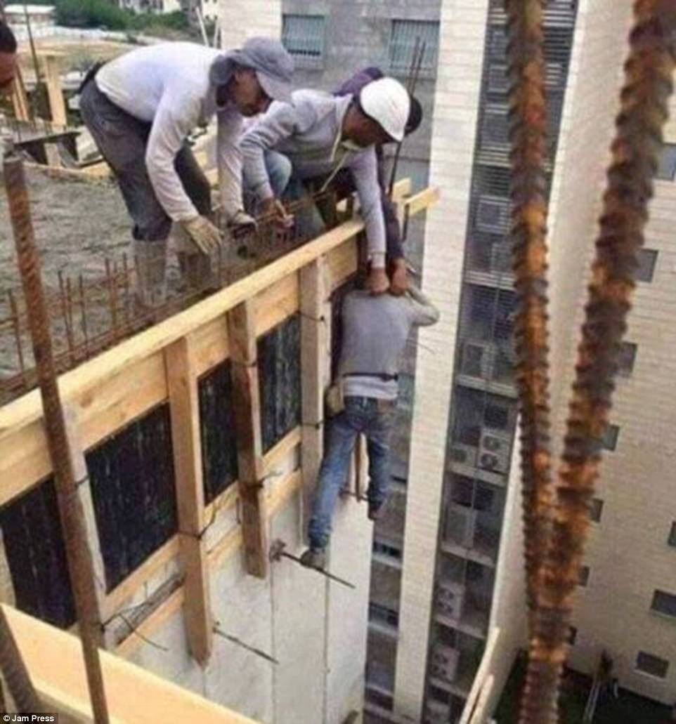
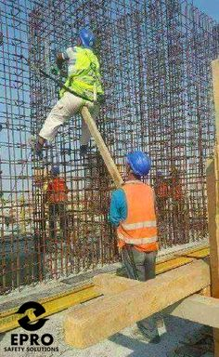
Mas work comp porn!

Slide 12
ARISING OUT OF
POSITIONAL RISK CONT’D
NETHERTON V LIGHTNING DELIVERY CO – EN ROUTE TO DELIVERY DRIVER STRUCK BY LIGHTNING
THIS IS ALSO NEUTRAL – ACT OF NATURE
CIRCLE K V. ICA - UNEXPLAINED FALLS AND DEATH PRESUMED
PF CHANGS - ASSAULTS – FIGHTS BETWEEN EMPLOYEES HAVE TO HAVE SOME TIE TO THE WORKPLACE
GOODYEAR AIRCRAFT – HIS OWN POP BOTTLE EXPLODED AS HE WAS PREPARING TO LOWER INTO THE COMPANY COOLER
THE HEAT OF HIS EMPLOYMENT MADE IT NECESSARY TO BRING TO WORK AND LEAVE ON THE SEAT OF HIS TRUCK UNTIL HE COULD RETURN FOR IT

Slide 13
Course of employment
TIME, PLACE AND CIRCUMSTANCES
REMEMBER – INJURY IN TIME, PLACE AND CIRCUMSTANCES OF EMPLOYMENT (COE), WILL ORDINARILY, BUT NOT NECESSARILY, ARISE OUT OF IT, WHILE AN INJURY ARISING OUT OF EMPLOYMENT ALMOST NECESSARILY OCCURS IN THE COE.
TELL THEM APART – WHEN ISSUE IS CONDUCT DELIBERATELY UNDERTAKEN BY CLAIMAINT, COE
WHEN ISSUE IS SOURCE OF THE INJURY TO CLAIMANT, ARISING OUT OF

Slide 14
COE
RULE OF THUMB – INJURED ON EMPLOYER PREMISES DOING REGULAR JOB DUTIES DURING REGULAR WORK HOURS = COE
EMPLOYEE TRAVELING TO OR FROM WORK GENERALLY NOT IN COE

Slide 15
COE
BUNKHOUSE RULE – EMPLOYEE REQUIRED TO LIVE ON EMPLOYER PREMISES AND INJURED WHILE REASONABLY USING THE PREMISES IS COE EVEN IF OFF DUTY
GOING AND COMING RULE

Slide 16
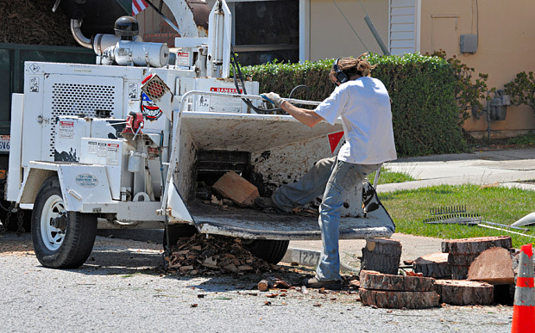
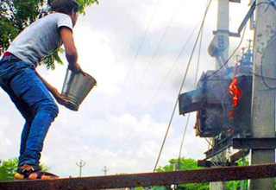
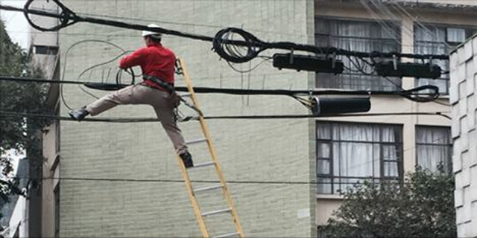
Mas work comp porn!

Slide 17
COE
EXCEPTIONS TO GOING AND COMING RULE
ON PREMISES
TRAVEL BETWEEN PREMISES
SPECIAL ERRAND
EMPLOYERS CONVEYANCE
PAYMENT FOR TRAVEL TIME/EXPENSES

Slide 18
COE
PERSONAL ACTIVITIES
AFTER HOURS USE OF PREMISES
RESCUE OR EMERGENCY
PERSONAL COMFORT RECREATIONAL AND SOCIAL ACTIVITIES

Slide 19
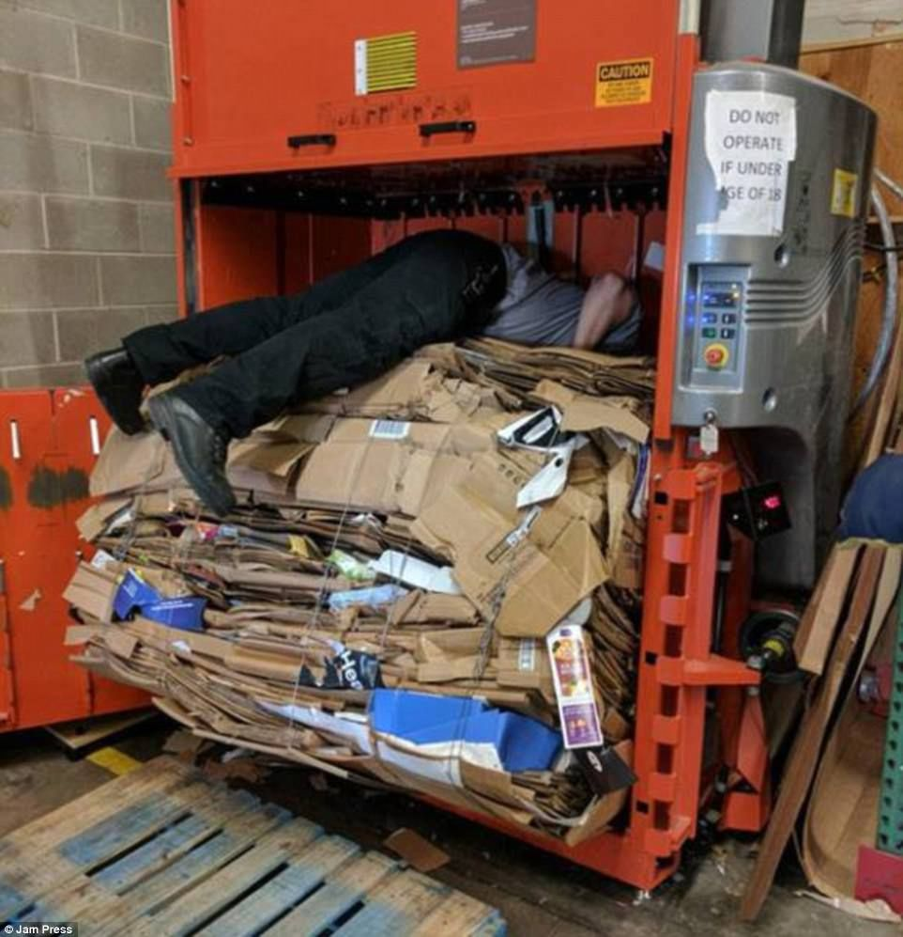
Mas work comp porn!

Slide 20
COE
RESCUE OR EMERGENCY
3 TYPES OF CASES
EMPLOYER HAS AN INTEREST
RESCUE OF STRANGERS
PRESSED INTO SERVICE

Slide 21
COE
PERSONAL COMFORT
GENERAL RULE – STAY IN COE WHILE
EATING LUNCH
SLEEPING
MAKING A PERSONAL PHONE CALL DURING BREAK
SMOKING
GOING TO THE BATHROOM
ACTS OF UNSUAL OR UNREASONABLE METHODS OR WHICH DEVIATE GREATLY FROM THE JOB, TAKE OUTSIDE OF COE

Slide 22
COE
RECREATIONAL AND SOCIAL ACTIVITIES
FOR COE, DEPENDS ON FACTS
NORMAL AND ACCEPTED ACTIVITIES ON EMPLOYER PREMISES DURING WORK TIMES ALMOST ALWAYS COE
OFF PREMISES, COE DEPENDS ON WHETHER EMPLOYER COMPELS AND BENEFITS FROM THE ACTIVITY

Slide 23
COE
IMPROPER ACTIVITIES
HORSEPLAY
DEPENDS WHETHER PERSON INJURED WAS PARTICIPANT OR NON PARTICIPATING VICTIM
NON PARTAKING VICTIM ALMOST ALWAYS COVERED
PARTICIPANT COULD GET COVERAHE IF THE HORSEPLAY WAS AN “INSUBSTANTIAL DEVIATION” FROM AUTHORIZED ACTIVITIES
INTOXICATION
GRAMMATICO V ICA – COVERED
SELF INFLICTED
NO COVERAGE IF CONSEQUENCES OF THE ACT AS WELL AS THE ACT ITSELF ARE INTENDED

Slide 24
COE
ILLEGAL CONDUCT
VIOLATION OF A LAW DOES NOT NECESSARILY TAKE ONE OUTSIDE COE
UNLESS SHOW EMPLOYEE INTENDED THE CONSEQUENCES OF THE ILLEGAL ACT.

Slide 25
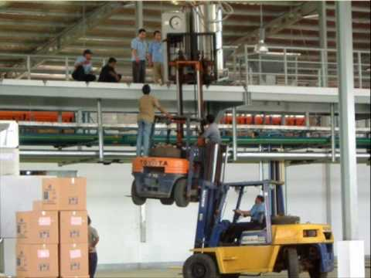
Mas work comp porn!

Slide 26
Q&a

